Slide 1

Mid-Term Spring Progress Report

Slide 2
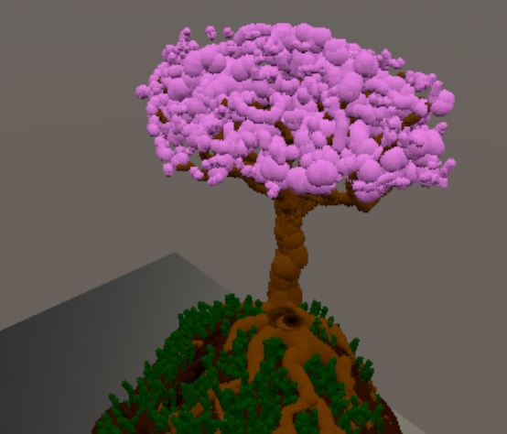
Our current state

Slide 3
Front End

Slide 4
Updates to the UI
Creating a diegetic UI
Creating target rays for UI selection

Slide 5
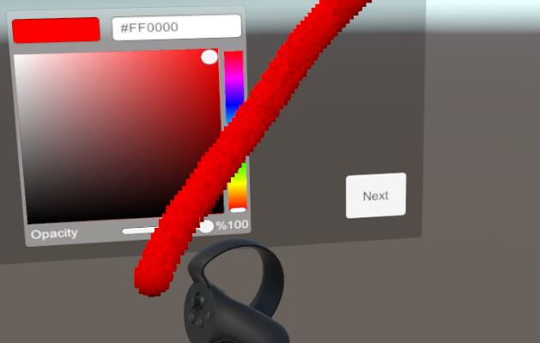

Slide 6
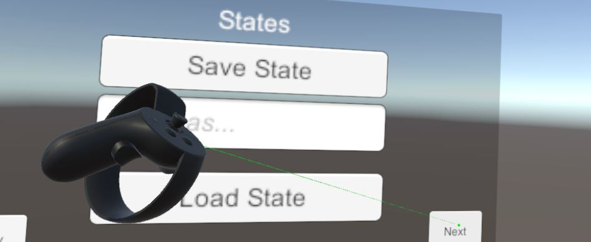

Slide 7
UI still in progress
Anchoring the UI to the head or the hand
Polishing and cleaning things up

Slide 8
Middle End

Slide 9
Color Selection
Arguably the most important from a practical standpoint
Primarily used existing frameworks to implement
Can now control HSV and alpha values

Slide 10
Save/Load Interface
Primary functionality already existed, but was inaccessible via interface
Employed OpenVR’s virtual keyboard to allow typing in VR

Slide 11
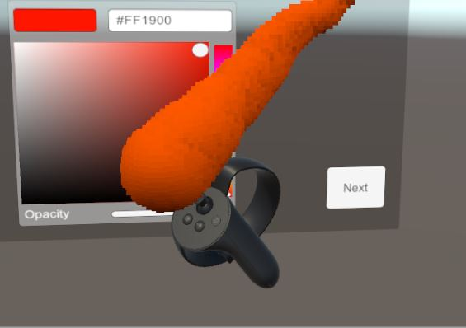
Brush Scaling
Simple to implement
Adds valuable functionality

Slide 12
Scene Scaling
Primarily developed on back-end
Relies on hand position
...Which is not the same as ‘tracked controller position’

Slide 13
What’s left to do
Continue work on interface
Perform user testing
Manage and organize team

Slide 14
Back End

Slide 15
Raster-Line Ray Tracing
Fixed-step Sampling
Original tracer stepped traces at a fixed rate
This lead to reduced performance and aliasing artifacts
Tracer was updated to sample voxels once per intersection, by order of intersection
Standard Line Raster Pattern
Raster-Line Tracing Pattern

Slide 16
Transparency
Voxel transparency was initially inaccurate
Altered falloff of light contribution to be exponential rather than linear
1.0
0.8
0.6
0.4
0.2
0.0
Linear Falloff Per Unit Traversed
Alpha = 0.8
1.0
0.8
0.64
0.512
0.4096
0.32768
Exponential Falloff Per Unit Traversed
Alpha = 0.8

Slide 17
Hierarchical Sampling in Ray Tracer
Reduces the number of steps required per-trace
Reduces the number of samples required per-trace
Increases Cache Efficiency
2D Color/Surface Grid Analog
2D SkipGrid Levels Analog

Slide 18
Brush Scaling
Brush scaling is possible as a component of the transformation used by the brush shader
Exposed to the user via the right joystick
Example of a starting and ending transformation, and the space interpolation used when calculating brush strokes.

Slide 19
Canvas Scaling
L
R
Scene navigation and scaling useful when making art
Analogous to pinching on a touch screen
L
R
Example of a starting and ending left and right controller position, and the resulting scaling/transformation

Slide 20
Conclusion

Slide 21
Demo

